Slide 1
MIXED-METHODS RESEARCH

Slide 2
Outline
Mixed Methods Research
1. Introduction to Mixed Methods Research
1.1 What is Mixed Methods Research?
2. Choosing a Mixed Methods Design
1.2 Worldviews and Mixed Methods Reseach
1.3 Quantitative and Qualitative Research
1.4 Research Problems Adressed by Mixed Methods
2.1 The Triangulation Design
2.2 The Embedded Design
2.3 The Explanatory Design
2.4 The Exploratory Design
3. Introducing a Mixed Method Study
4. Collecting Data in Mixed Methods Research
5. Analyzing Data in Mixed Methods Research
6. Reviewing Mixed Methods Studies (Ch3&Appendicies)

Slide 3
1. Introduction to Mixed Methods Research
1.1 What is Mixed Methods Research?
1. Introduction to Mixed Methods Research
1.2 Worldviews and Mixed Methods Reseach
1.3 Quantitative and Qualitative Research
1.4 Research Problems Adressed by Mixed Methods
2.1 The Triangulation Design
Mixed Methods Research
2.2 The Embedded Design
2. Choosing a Mixed Methods Design
2.3 The Explanatory Design
3. Introducing a Mixed Method Study
2.4 The Exploratory Design
4. Collecting Data in Mixed Methods Research
5. Analyzing Data in Mixed Methods Research
6. Reviewing Mixed Methods Studies (Ch3&Appendicies)

Slide 4
1.1 What is Mixed Methods Research?
Before answer what mixed methods reseach is, let’s think about:
What is methodology?
What is research design?
What is research method?
Methodology -> Philosophical framework and the fundamental assumptions of research (van Manen, 1990)
Research Design -> The plan of action that links the philosophical assumptions to specific methods (Creswell, 2003; Crotty, 1998)
Research Method -> Techniques of data collection and analysis such as quantitative standardized instrument or qualitative theme analysis of text data (Creswell, 2003; van Manen, 1990)

Slide 5
1.1 What is Mixed Methods Research?
Definition:
Mixed methods research is a research design with philosophical assumptions as well as methods of inquiry.
As a methodology, it involves philosophical assumptions that guide the direction of the collection and analysis of data and the mixture of qualitative and quantitative approaches in many phases in the research process.
As a method, it focuses on collecting, analyzing and mixing both quantitative and qualitative data in a single study or series of studies.
Its central premise is that the use of quantitative and qualitative approaches in combination provides a better understanding of research problems than either approach alone.
(Creswell, 2003)

Slide 6
1.1 What is Mixed Methods Research?
According to the definition, mixed methods reseach involves both collecting and analyzing quantitative and qualitative data.
What is quantitative data?
What is qualitative data?
Quantitative data -> Quantitative data includes closed-ened information such as that found on attitude, behavior or performance instruments.
Qualitative data-> Qualitative data consists of open-ended information that the researcher gathers through interviews with participants.

Slide 7
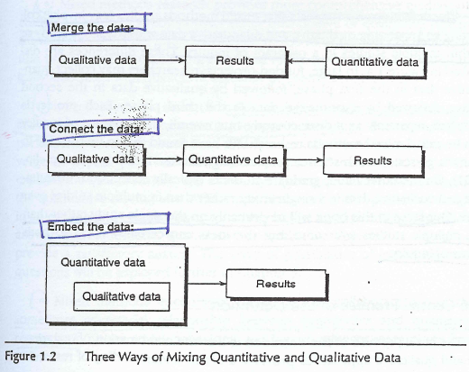
1.1 What is Mixed Methods Research?
According to the definition, data are mixed in some way to form a more complete picture of the problem than they do when standing alone.
What are the ways of mixing data?

Slide 8
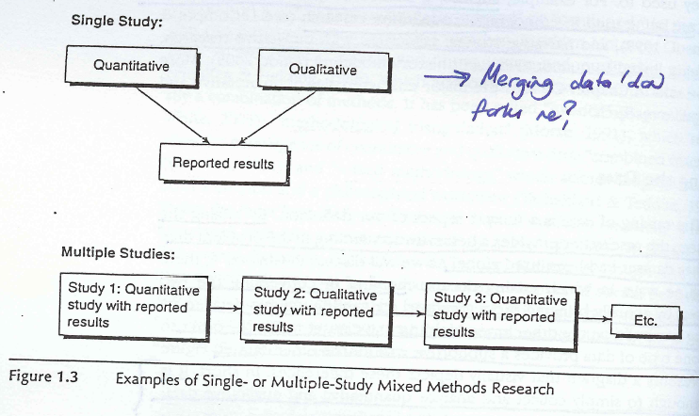
1.1 What is Mixed Methods Research?
According to the definition, mixed methods research is used both in single or series of studies.
What is single study?
What are series of studies?

Slide 9
1.1 What is Mixed Methods Research?
The central premise of the definition:
Mixed Methods Design
Provides strengths (quantitative is weak understanding the context, qualitative is weak due to researcher bias)
Helps answer questions that cannot be answered by Qual or Quan approaches alone. Ex: will a treatment work with a particular sample in an experiment?
Encourage researchers to collaborate
Encourage to use multiple worldviews
Is practical

Slide 10
1.1 What is Mixed Methods Research?
Studies that fit the definition?
Ex: A researcher collects data using a quantitative survey instrument and follows up with interviews with a few individuals who participated in the survey responses.
Studies in the gray areas?
Ex: A typical content analysis study. The researcher collects only qualitative data but analyze the data both qualitatively and quantitatively.

Slide 11
1.2 Worldviews and Mixed Methods Research
What is “worldview” or “paradigm”?
What worldviews exist?
What are the philosophical elements of all worldviews?
Why are the worldviews important in a research?
What is your position about reality, how knowledge is obtained, an the methods of gaining knowledge?
What are the alternative positions on worldviews and mixed methods research?

Slide 12
1.2 Worldviews and Mixed Methods Research
What is “worldview” or “paradigm”?
Worldview and paradigm mean how we view the world and, thus, go about conducting research. They contain basic set of beliefs or assumptions that guide our inquiries (Guba, Lincoln, 2005)

Slide 13
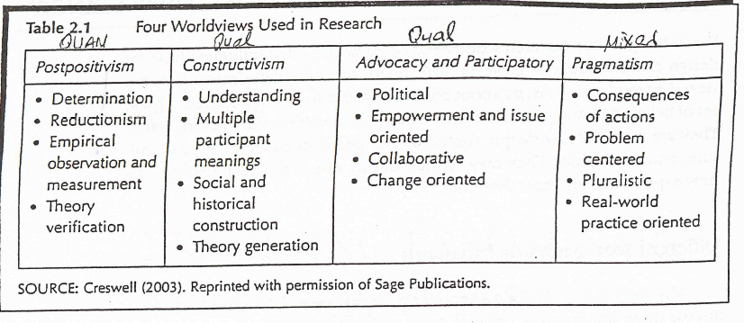
1.2 Worldviews and Mixed Methods Research
What worldviews exist?

Slide 14
1.2 Worldviews and Mixed Methods Research
What are the philosophical elements of all worldviews?
Epistemology -> How we gain knowledge of what we know
Axiology -> The role values play in research
Methodology -> The process of research
Rhetoric -> The language of research

Slide 15
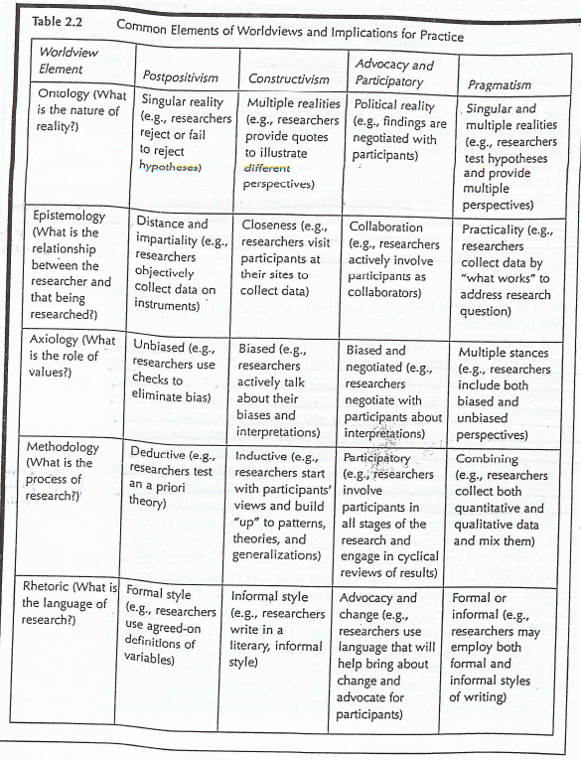
1.2 Worldviews and Mixed Methods Research

Slide 16
1.2 Worldviews and Mixed Methods Research
Why are the worldviews important in a research?
All research needs a foundation for its inquiry, and inquirers need to be aware of the implicit/hidden worldviews they bring to their studies.
Some researchers make their worldviews explicit by discussing them in their research; others recognize their presence but do not actively discuss in their research. Still others are not familiar with the philosophical foundations of the different methods of conducting research.
What is your position about reality, how knowledge is obtained, an the methods of gaining knowledge?

Slide 17
1.2 Worldviews and Mixed Methods Research
What are the alternative positions on worldviews and mixed methods research?
There is one “best” paradigm or worldview that fits mixed methods research (Tashakkori and Teddlie (2003) formally linked pragamtism and mixed methods research).
Researchers can use multiple paradigms or worldviews in their mixed methods study. This stance emphasizes using multiple paradigms (i.e., constructivism and advocacy) during the study instead of using one overall paradigm, such as pragmatism.
Worldviews relate to the type of mixed methods design and may vary depending on the type of design. This perspective suggest that investigators may view mixed methods research as a “method”, thus allowing researchers to employ any number of philosophical foundations for its justification and use.

Slide 18
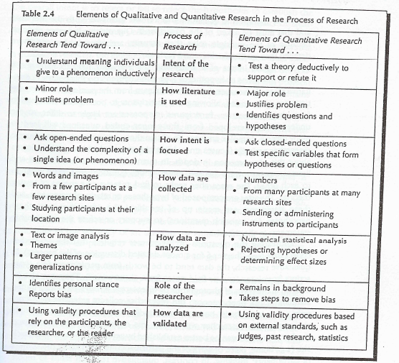
1.3 Quantitative and Qualitative Research
No single study perfectly fits all of the elements of either qualitative or quantitative.

Slide 19
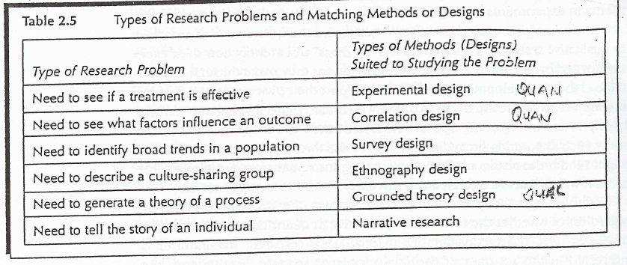
1.4 Research Problems Adressed by Mixed Methods
Types of problems addressed by quantitative and qualitative designs:

Slide 20
Research Problems Adressed by Mixed Methods
The “rationale” or “reasons” for using mixed methods design:
A need exists for both quantitative and qualitative approaches
A need exists to enhance the study with a second source of data
A need exists to explain the quantitative results
A need exists to fist explore qualitatively

Slide 21
2. Choosing a Mixed Methods Design
1.1 What is Mixed Methods Research?
1. Introduction to Mixed Methods Research
1.2 Worldviews and Mixed Methods Reseach
1.3 Quantitative and Qualitative Research
1.4 Research Problems Adressed by Mixed Methods
2.1 The Triangulation Design
Mixed Methods Research
2.2 The Embedded Design
2. Choosing a Mixed Methods Design
2.3 The Explanatory Design
3. Introducing a Mixed Method Study
2.4 The Exploratory Design
4. Collecting Data in Mixed Methods Research
5. Analyzing Data in Mixed Methods Research
6. Reviewing Mixed Methods Studies (Ch3&Appendicies)

Slide 22
2. Choosing a Mixed Methods Design
Once the researcher have selected a mixed methods approach for a study, the next step is to decide the design.
Tashakkori and Teddlie (2003) noted that they had found nearly 40 different mixed methods design in the literature.
Creswell and Clark (2007) suggest four major mixed methods designs, with variants within each type.

Slide 23
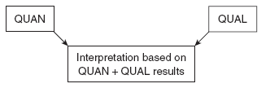
2.1 The Triangulation Design
Most common and well-known approach.
Purpose is “to obtain different but complementary data on the same topic” (Morse, 1991, p. 122) to best understand the research problem.
Is used when the researcher wants to directly compare and contrast quantitative statistical results with qualitative findings or to validate or expand quantitative results with qualitative data.

Slide 24
2.1 The Triangulation Design
Triangulation Design -> Convergence Model
In this model, the researcher collects and analyzes quantitative and qualitative data separately on the same phenomenon then the different results are converged.
Researchers use this model when they want to compare results or to validate, confirm, or corroborate quantitative results with qualitative findings.

Slide 25
2.1 The Triangulation Design
Triangulation Design -> Data Transformation Model
After the initial analysis, the researcher uses procedures to transform one data type into the other data type. This is accomplished by either quantifying qualitative findings or qualifying quantitative results (Tashakkori & Teddlie, 1998)

Slide 26
2.1 The Triangulation Design
Triangulation Design -> Validating Quantitative Data Model
This model is used to validate and expand on the quantitative findings from a survey by including a few open-ended qualitative questions.

Slide 27
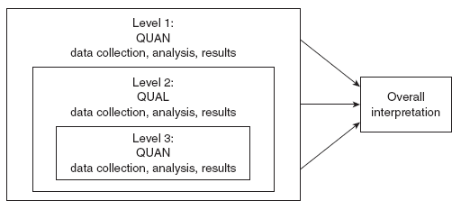
2.1 The Triangulation Design
Triangulation Design -> Multilevel Model
In a multilevel model, different methods (quantitative and qualitative) are used to address different levels within a system. The findings from each level are merged together into one overall interpretation.

Slide 28
2.1 The Triangulation Design
Strengths of the Triangulation Design
Researchers new to mixed methods often choose this design. It was the design first discussed in the literature (Jick, 1979), and it has become a framework for thinking about mixed methods research.
It is an efficient design, in which both types of data are collected during one phase of the research at roughly the same time.
Each type of data can be collected and analyzed separately and independently, using the techniques traditionally associated with each data type.

Slide 29
2.1 The Triangulation Design
Challenges in Using the Triangulation Design
Much effort and expertise is required, particularly because of the concurrent data collection and the fact that equal weight is usually given to each data type.
Researchers may face the question of what to do if the quantitative and qualitative results do not agree. These differences can be difficult to resolve and may require the collection of additional data.

Slide 30
2.2 The Embedded Design
The Embedded Design is a mixed methods design in which one data set provides a supportive, secondary role in a study based primarily on the other data type (Creswell, Plano Clark, et al., 2003).
The Embedded Design mixes the different data sets at the design level, with one type of data being embedded within a methodology framed by the other data type (Caracelli & Greene, 1997).
This design is particularly useful when a researcher needs to embed a qualitative component within a quantitative design, as in the case of an experimental or correlational design.

Slide 31
2.2 The Embedded Design
The Embedded Design -> Embedded Experimental Model
This model is defined by having qualitative data embedded within an experimental design (such as a true experiment or a quasiexperiment).

Slide 32
2.2 The Embedded Design
The Embedded Design -> Embedded Correlational Model
In this design, researchers collect qualitative data as part of their correlational study to help explain how the mechanisms work in the correlational model.

Slide 33
2.2 The Embedded Design
Strengths of the Embedded Design
It can be used when a researcher does not have sufficient time or resources to commit to extensive quantitative and qualitative data collection because one data type is given less priority than the other.
This design may be logistically more manageable for graduate students because one method requires less data than the other method.

Slide 34
2.2 The Embedded Design
Challenges in Using the Embedded Design
The researcher must specify the purpose of collecting qualitative (or quantitative) data as part of a larger quantitative (or qualitative) study.
It can be difficult to integrate the results when the two methods are used to answer different research questions. Researchers using an Embedded Design can keep the two sets of results separate in their reports or even report them in separate papers

Slide 35
2.3 Explanatory Design
Two phase mixed methods design
The purpose of this design is that qualitative data helps explain or build upon initial quantitative results
QUAN
qual
Interpretation based on QUAN qual results

Slide 36
2.3 Explanatory Design
Variants of the Explanatory Design
Follow-up Explanations Model (QUAN emphasized)
QUAN data collection
QUAN data analysis
QUAN results
Identify results for follow up
Qual data collection
Qual data analysis
Qual results
Interpretation
QUAN qual
Participant Selection Model (QUAL emphasized)
quan data collection
quan data analysis
quan results
QUAL participant selection
QUAL data collection
QUAL data analysis
QUAL results
Interpretation
quan QUAL

Slide 37
2.3 Explanatory Design
Follow-up Explanations Model
This model is used when a researcher needs qualitative data to explain or expand on quantitative results
The resarcher identifies specific quantitative findings that need additional explanation, such as statistical differences among groups, or individuals who scored at extreme levels.
Ivankova (2004), in the initial quan phase, collected quan survey data to identify factors predictive of students’ persistence. In the second phase, she used a qual multiple case study approach to help explain why certain factors identified in the first phase were significant predictors of student persistence in the program.

Slide 38
2.3 Explanatory Design
Participant Selection Model
This model is used when a researcher needs quantitative information to identify and purposefully select participants for a follow up qualitative study.
For instance, May and Etkina (2002) collected quantitative data to identify physics students with consistently high and low conceptual learning gains. They then completed an in-depth qualitative comparison study of these students’ perceptions of learning.

Slide 39
2.4 Exploratory Design
This model is useful for developing and testing an instrument or identifying important variables to study quantitatively.
It is also appropriate for generalizing results to different groups or exploring a phenomenon in depth.
QUAL
quan
Interpretation based on QUAL quan results

Slide 40
2.4 Exploratory Design
Variants of the Exploratory Design
Instrument Development Model (QUAN emphasized)
qual data collection
qual data analysis
qual results
Develop instrument
QUAN data collection
QUAN data analysis
QUAN results
Interpretation
qual QUAN
Taxonomy Development Model (QUAL emphasized)
QUAL data collection
QUAL data analysis
QUAL results
Develop taxonomy or theory for testing
quan data collection
quan data analysis
quan results
Interpretation
QUAL quan

Slide 41
2.4 Exploratory Design
Instrument Development Model
It is used for developing and implementing a quantitative instrument based on qualitative findings.
The qualitative findings guide the development of items an scales for a quantitative survey instrument.
The researcher implements and validates the instrument quantitatively

Slide 42
2.4 Exploratory Design
Taxonomy Development Model
It is used when a researcher formulates quantitative research questions or hypotheses based on qualitative findings
Initial qualitative phase is conducted to identify important variables or develop a taxonomy and the secondary, quantitative phase tests or studies these results in more detail

Slide 43
Selecting a Type of Mixed Methods Design
Weighting
Equal weight
Unequal weight
Quantitative emphasis
Qualitative emphasis
Timing
Concurrent timing
Sequential timing
Quantitative first
Qualitative first

Slide 44
Selecting a Type of Mixed Methods Design
Mixing
Merge the data
Embed the data
Embed qualitative data in a quantitative design
Embed quantitative data in a qualitative design
Connect the data
Merging results during interpretation
Merging data during analysis
Quantitative leads to qualitative
Qualitative builds to quantitative

Slide 45
Major Mixed Methods Design Types
Design Type | Variants | Timing | Weighting | Mixing | Notation
Triangulation | Convergence Data transformation Validating quantitative data Multilevel | Concurrent: quantitative and qualitative at same time | Usually equal | Merge the data during the interpretation or analysis | QUAN + QUAL
Embedded | Embedded experimental Embedded correlational | Concurrent or sequential | Unequal | Embed one type of data within a larger design using the other type of data | QUAN (qual) or QUAL (quan)
Explanatory | Follow-up explanations Participant selection | Sequential: Quantitative followed by qualitative | Usually quantitative | Connect the data between the two phases | QUAN qual
Exploratory | Instrument development Taxonomy development | Sequential: Qualitative followed by quantitative | Usually qualitative | Connect the data between the two phases | QUAN qual

Slide 46
3. Introducing a Mixed Methods Study
1.1 What is Mixed Methods Research?
1. Introduction to Mixed Methods Research
1.2 Worldviews and Mixed Methods Reseach
1.3 Quantitative and Qualitative Research
1.4 Research Problems Adressed by Mixed Methods
2.1 The Triangulation Design
Mixed Methods Research
2.2 The Embedded Design
2. Choosing a Mixed Methods Design
2.3 The Explanatory Design
3. Introducing a Mixed Method Study
2.4 The Exploratory Design
4. Collecting Data in Mixed Methods Research
5. Analyzing Data in Mixed Methods Research
6. Reviewing Mixed Methods Studies (Ch3&Appendicies)

Slide 47
3.1 Mixed Methods Titles
It is short and succinct.
It mentions the major topic being addressed, the participants in the study, and the location or site of the project.
It includes the words mixed methods to highlight the type of design being used
It contains words that suggest the specific type of mixed methods design

Slide 48
3.1 Mixed Methods Titles
Triangulation Design
Original title: Adolescent Development and Transitions to Motherhood (Flanagan, McGrath, Meyer, & Garcia Coll, 1995)
Revised title: Adolescent Development and Transitions to Motherhood: A Mixed Methods Study

Slide 49
3.1 Mixed Methods Titles
Embedded Design
Original title: Reactions of participants to the results of a randomised controlled trial: Exploratory Study (Snowdon, Garcia, & Elboune, 1998)
Revised title: Reactions of participants to the results of a randomised controlled trial: A Mixed Methods Investigation

Slide 50
3.1 Mixed Methods Titles
Explanatory Design
A quantitative and qualitative inquiry into the attitudes toward science of nonscience college students (Gogolin & Swartz, 1992)
Depression and Substance Use in Two Divergent High School Cultures: A Quantitative and Qualitative Analysis (Way et al., 1994)

Slide 51
3.1 Mixed Methods Titles
Exploratory Design
Original title: Family Portraits: Stories as Standards for Family Relationships (Vangelisti, Crumley, & Baker, 1999)
Revised title: Family Portraits Formed Through Mixed Methods: Stories as Standards for Family Relationships

Slide 52
3.2 Mixed Methods Purpose Statements
Include the overall content aim of the project in the first sentence
Identify the type of mixed methods design
Designate the forms of data collection
Mention the site where the research will take place
State the reasons for collecting both forms of data

Slide 53
3.2 Mixed Methods Purpose Statemets
An example of purpose statement for Explanatory Design
The intent of this study is to examine Latino adolescents’ perspectives on family conflict. The purpose of this two-phase, explanatory mixed methods study will be to obtain statistical quantitative results from a sample and then follow up with a few individuals to probe or explain those results in more depth. In the first phase, quantitative hypotheses will address the relationship of acculturation and family conflict with Latino adolescents at their respective middle school and/or high school in Southern California. In the second phase, qualitative semi structured interviews will be used in a multiple case study to explore aspects of family conflict with 4 individuals representing different combinations (from the quantitative results) at a Middle School and a High School. The reason for the qualitative follow-up data is to better understand the quantitative results from the first phase of the project (Cerda, 2005).

Slide 54
3.3 Mixed Methods Research Questions
Type of Design | Variants | Examples of Mixed Methods Research Questions
Triangulation design |  | To what extent do the quantitative and qualitative data converge? How and why?
 |  | To what extent do the same types of data confirm each other?
 |  | To what extent do the open-ended themes support the survey results?
 |  | What similarities and differences exist across level of analysis?
Embedded design |  | How do the qualitative results inform the development of the treatment?
 |  | How does the qualitative data add to an understanding of the mechanisms in the correlational model?
Explanatory design |  | In what ways do the qualitative data help to explain the quantitative results?
 |  | Which cases provide the best insights into the quantitative results?
Exploratory design |  | What items and scales represent the qualitative results?
 |  | What variables or taxonomy emerge from the qualitative data that were not known beforehand?

Slide 55
3.3 Mixed Methods Research Questions
Type of Design | Variants | Examples of Mixed Methods Research Questions
Triangulation design | Convergence | To what extent do the quantitative and qualitative data converge? How and why?
 | Data transformation | To what extent do the same types of data confirm each other?
 | Validating quantitative data | To what extent do the open-ended themes support the survey results?
 | Multilevel | What similarities and differences exist across level of analysis?
Embedded design | Embedded experimental | How do the qualitative results inform the development of the treatment?
 | Embedded correlational | How does the qualitative data add to an understanding of the mechanisms in the correlational model?
Explanatory design | Follow-up explanations | In what ways do the qualitative data help to explain the quantitative results?
 | Participant selection | Which cases provide the best insights into the quantitative results?
Exploratory design | Instrument development | What items and scales represent the qualitative results?
 | Taxonomy development | What variables or taxonomy emerge from the qualitative data that were not known beforehand?

Slide 56
4. Collecting Data in Mixed Methods Research
1.1 What is Mixed Methods Research?
1. Introduction to Mixed Methods Research
1.2 Worldviews and Mixed Methods Reseach
1.3 Quantitative and Qualitative Research
1.4 Research Problems Adressed by Mixed Methods
2.1 The Triangulation Design
Mixed Methods Research
2.2 The Embedded Design
2. Choosing a Mixed Methods Design
2.3 The Explanatory Design
3. Introducing a Mixed Method Study
2.4 The Exploratory Design
4. Collecting Data in Mixed Methods Research
5. Analyzing Data in Mixed Methods Research
6. Reviewing Mixed Methods Studies (Ch3&Appendicies)

Slide 57
4.1 Concurrent Forms of Mixed Methods Data Collection
QUAN or quan data collection
- Data collected at same time
- Independent of each other
- Same level (Triangulation Convergence Design) or different levels (Triangulation Multilevel Design)
- Given equal (Triangulation Convergence) or unequal priority (Embedded Design, Triangulation Validating Quantitative Design
QUAN or quan data analysis
QUAL or qual data analysis
Analyzed for different purposes: converge findings, validate other form of data, transformed for comparisons, analyzed for different types of questions
QUAL or qual data collection

Slide 58
4.2 Sequential Forms of Mixed Methods Data Collection
Data collection
QUAL or QUAN
How will Stage 1 results be used in Stage 3?
- Further explained (Explanatory Follow-up Design, Embedded Design)
- To select participants (Explanatory Participant Selection Design, Exploratory Taxonomy Design)
- To develop and test an instrument (Exploratory instrument Development Design)
- To develop and test a taxonomy (Exploratory Taxonomy Development Design)
- To develop an intervention (Embedded Design)
Data analysis
QUAL or QUAN
Data analysis
Quan or qual
Data collection
Quan or qual
Stage 1
Stage 2
Stage 3

Slide 59
5. Analyzing Data in Mixed Methods Research
1.1 What is Mixed Methods Research?
1. Introduction to Mixed Methods Research
1.2 Worldviews and Mixed Methods Reseach
1.3 Quantitative and Qualitative Research
1.4 Research Problems Adressed by Mixed Methods
2.1 The Triangulation Design
Mixed Methods Research
2.2 The Embedded Design
2. Choosing a Mixed Methods Design
2.3 The Explanatory Design
3. Introducing a Mixed Method Study
2.4 The Exploratory Design
4. Collecting Data in Mixed Methods Research
5. Analyzing Data in Mixed Methods Research
6. Reviewing Mixed Methods Studies (Ch3&Appendicies)

Slide 60
5.1 Concurrent Data Analysis Procedures in Triangulation and Embedded Designs
- Merge the two datasets
- Transform the data and relate or compare the data
- Compare the results (discussion or matrices)
QUAL data analysis
- Prepare the data
- Explore the data
- Analyze the data
- Represent the results
QUAN data analysis
- Prepare the data
- Explore the data
- Analyze the data
- Represent the results
Stage 1. Seperate QUAL and QUAN analyses
Stage 2. Merge the two datasets

Slide 61
5.2 Sequential Data Analysis Procedures in Embedded and Explanatory Designs
Stage 1. Seperate QUAN data analysis
Stage 2. Identify QUAN results to use
Stage 3. Apply select QUAN results to qual phase
QUAN data analysis
Options
- Outliers
- Extreme cases
- Significant-nonsignificant results
- Demographics
- Comparison groups
- Select cases
- Explain results
- Compare groups

Slide 62
5.3 Sequential Data Analysis Procedures in Embedded and Exploratory Designs
Stage 1. Seperate QUAL data analysis
Stage 2. Identify QUAL results to use
Stage 3. Apply select QUAL results to qual phase
QUAL data analysis
Options
- Codes and themes
- Significant statements
- Models
- To recruit cases
- To shape intervention
- To test QUAL model
- To develop an instrument

Slide 63
5.4 Potential Threats to the Validity of Concurrent Designs
Concurrent Designs (Triangulation, Embedded) | Minimizing the Threat
Data collection issues Selecting different individuals for the qualittive and quantitative data collection Unequal sample sizes for the qualitative and quantitative dta collection Not following up on contradictory results Introducing potential bias through dat collection | Draw quantitative and qualitative samples from same population Use large qualitative samples or weight the cases Follow up on contradictory results or reexamine data Use unobtrusive data collection procedures
Data analysis issues Inadequate data transformation approaches Inadequate approaches to coverging the data Not addressing validity issues Two types of data do not address the same question | Keep the transformation straightforward (e.g count codes or themes and weight them) Develop a matrix with quantitative categorical data and qualitative themes Address pote. issues for quan and qual valid. Address the same question in both quan and qual approaches

Slide 64
5.5 Potential Threats to the Validity of Sequential Designs
Sequential Designs (Explanatory, Exploratory, Embedded) | Minimizing the Threat
Data collection issues Selecting the same or different individuals for the qualitative and quantitative data collection Using the same sample sizes for the qualitative and quantitative dta collection Not choosing participants for the follow-up who help explain significant results Not designing an instrument with sound psychometric properties | Select the same ndividuals for an Explanatory Design and different individuals for the Exploratory Design Use large sample for quantitative and small sample size for qualitative Choose same individuals for the qual follow-up and the quan first phase Use rigorous procedures for developing and validating the new instrument
Data analysis issues Choosing weak quan results to follow up on qualitatively Choosing weak qual findings to follow up on quantitatively Not addressing validity issues | Choose significant results or strong predictors to follow up on Use major themes as the basis for the quan follow up Address both quan and qual validity

Slide 65
6. Reviewing Mixed Methods Studies
1.1 What is Mixed Methods Research?
1. Introduction to Mixed Methods Research
1.2 Worldviews and Mixed Methods Reseach
1.3 Quantitative and Qualitative Research
1.4 Research Problems Adressed by Mixed Methods
2.1 The Triangulation Design
Mixed Methods Research
2.2 The Embedded Design
2. Choosing a Mixed Methods Design
2.3 The Explanatory Design
3. Introducing a Mixed Method Study
2.4 The Exploratory Design
4. Collecting Data in Mixed Methods Research
5. Analyzing Data in Mixed Methods Research
6. Reviewing Mixed Methods Studies (Ch3&Appendicies)

